Slide 1
Modo oscuro usando Material design con Flutter

Slide 2
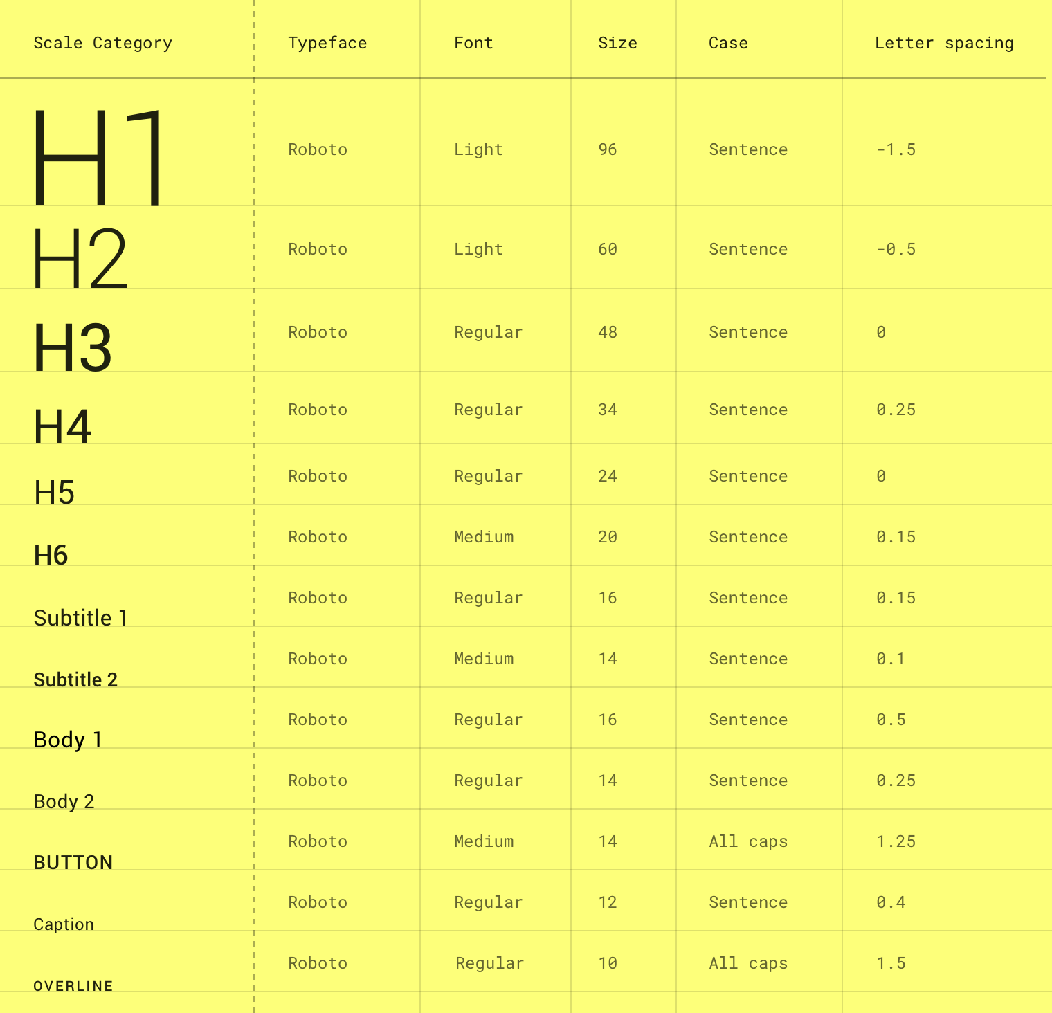
Fuente del texto
https://api.flutter.dev/flutter/material/TextTheme-class.html

Slide 3
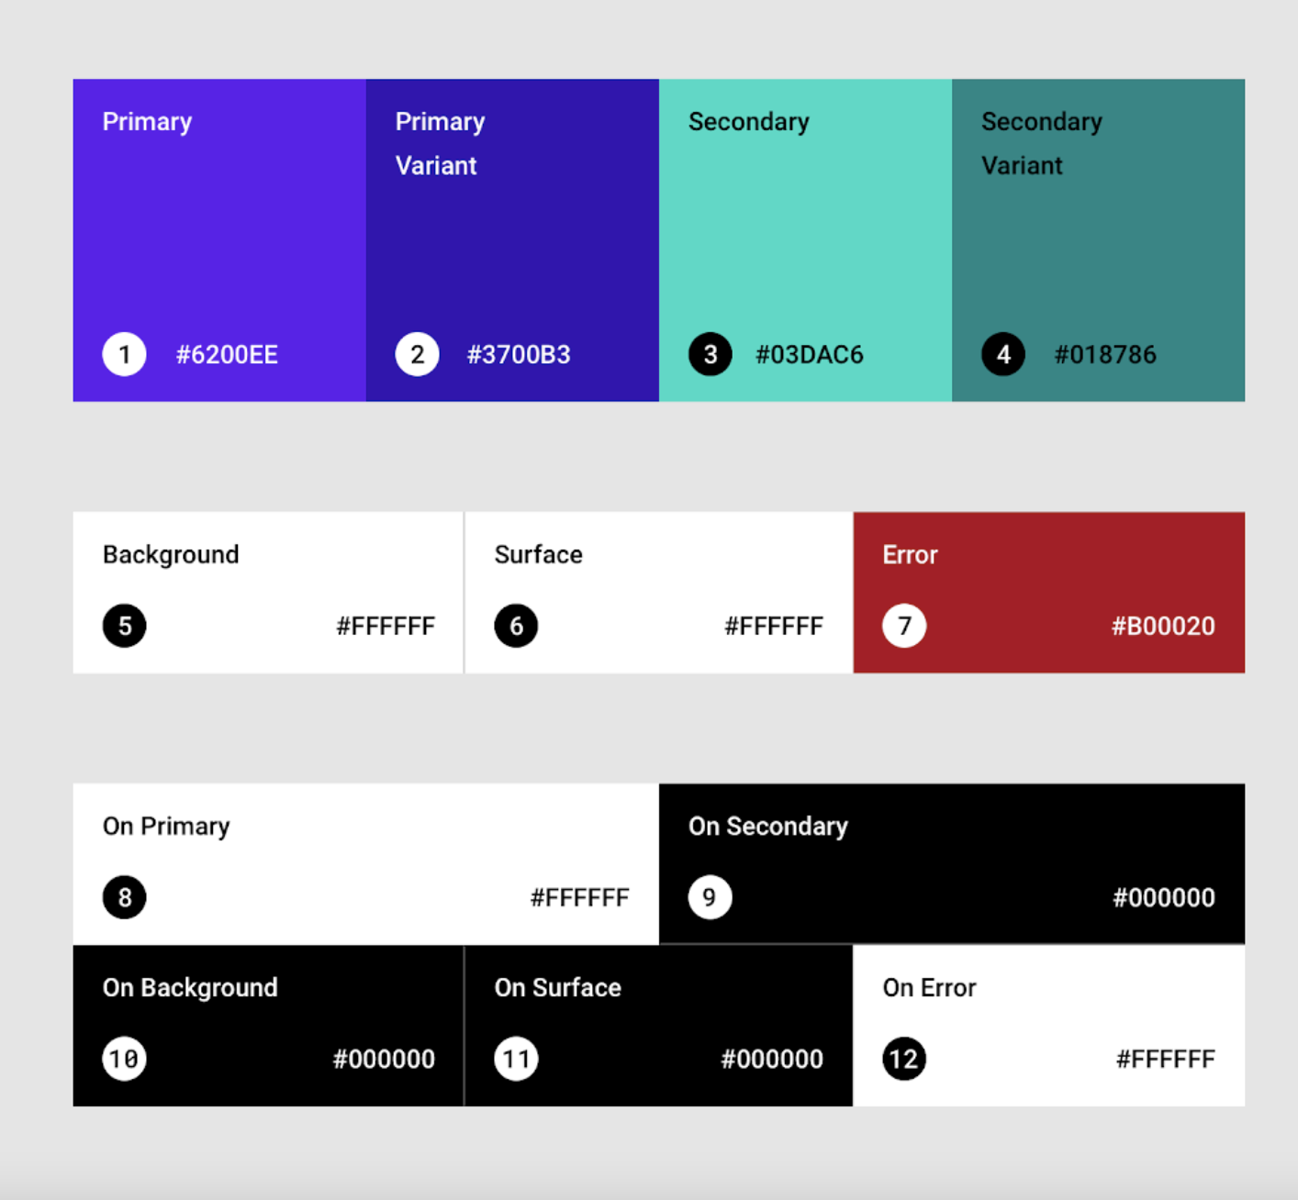
Colores
Tema claro
“On” sobre el elemento
https://material.io/design/color/the-color-system.html#color-theme-creation

Slide 4
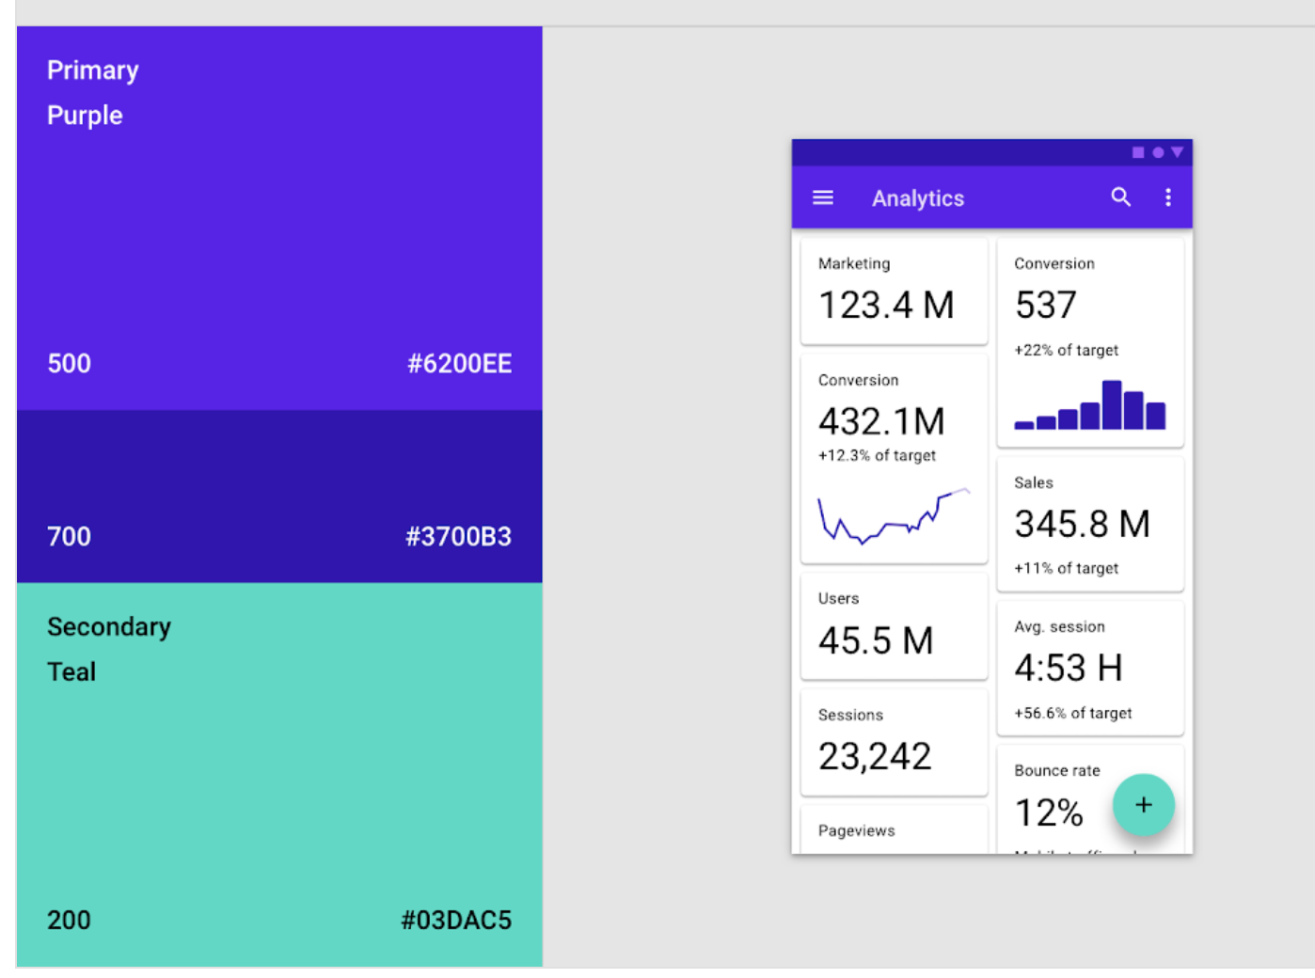
Ejemplo
Primary
Primary variante
Primary variante
secondary
https://material.io/design/color/the-color-system.html#color-theme-creation

Slide 5
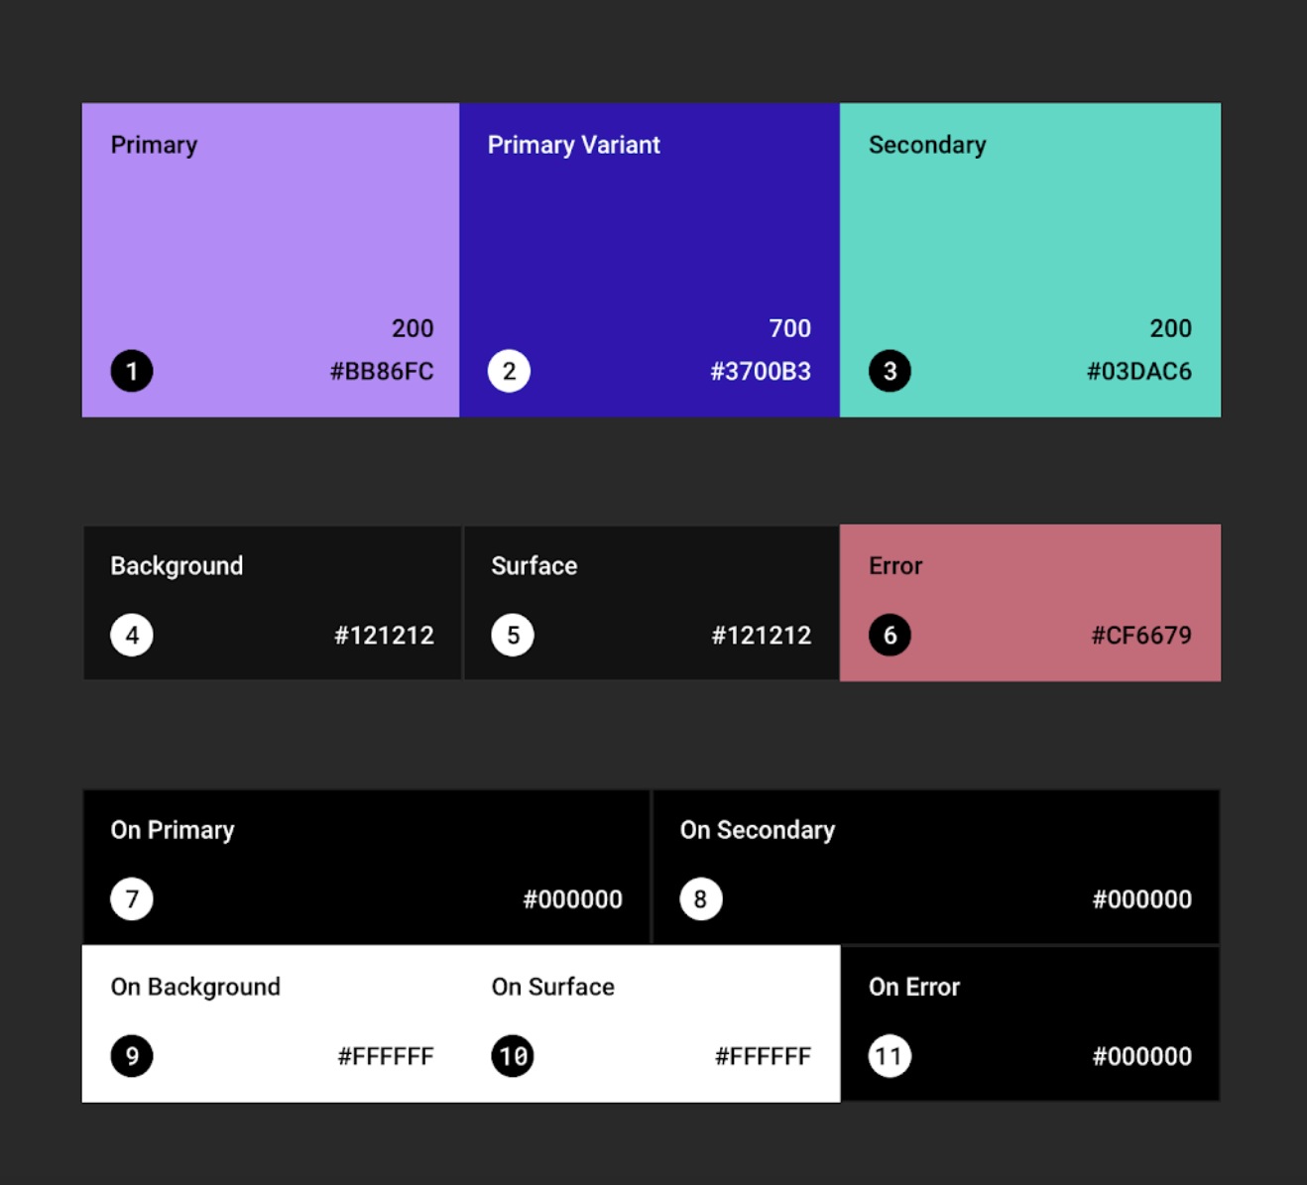
Colores
Tema oscuro
“On” sobre el elemento
https://material.io/design/color/dark-theme.html#usage

Slide 6
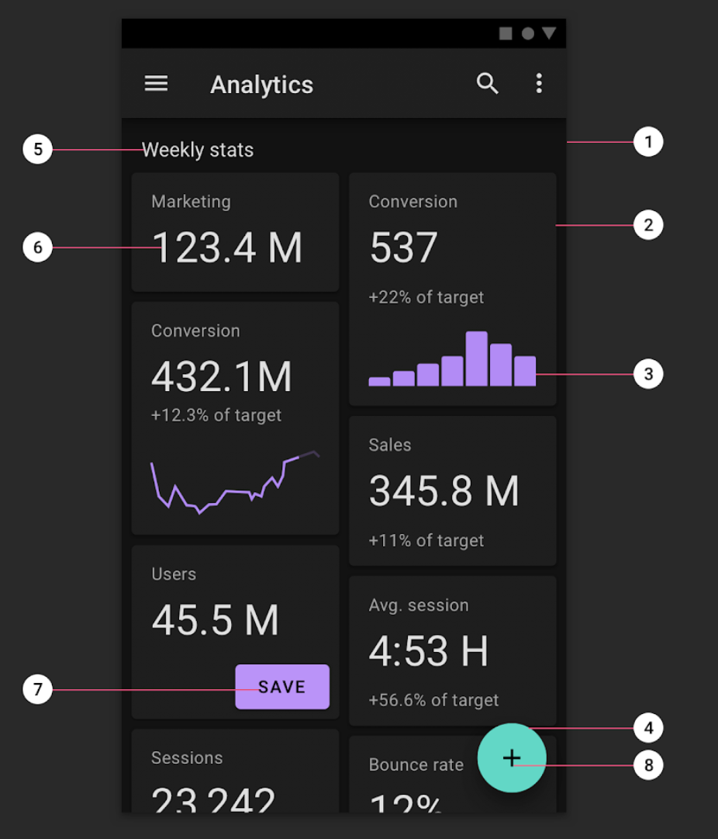
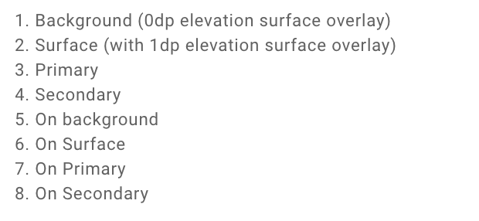
Ejemplo
On sobre el elemento
https://material.io/design/color/dark-theme.html#usage

Slide 7
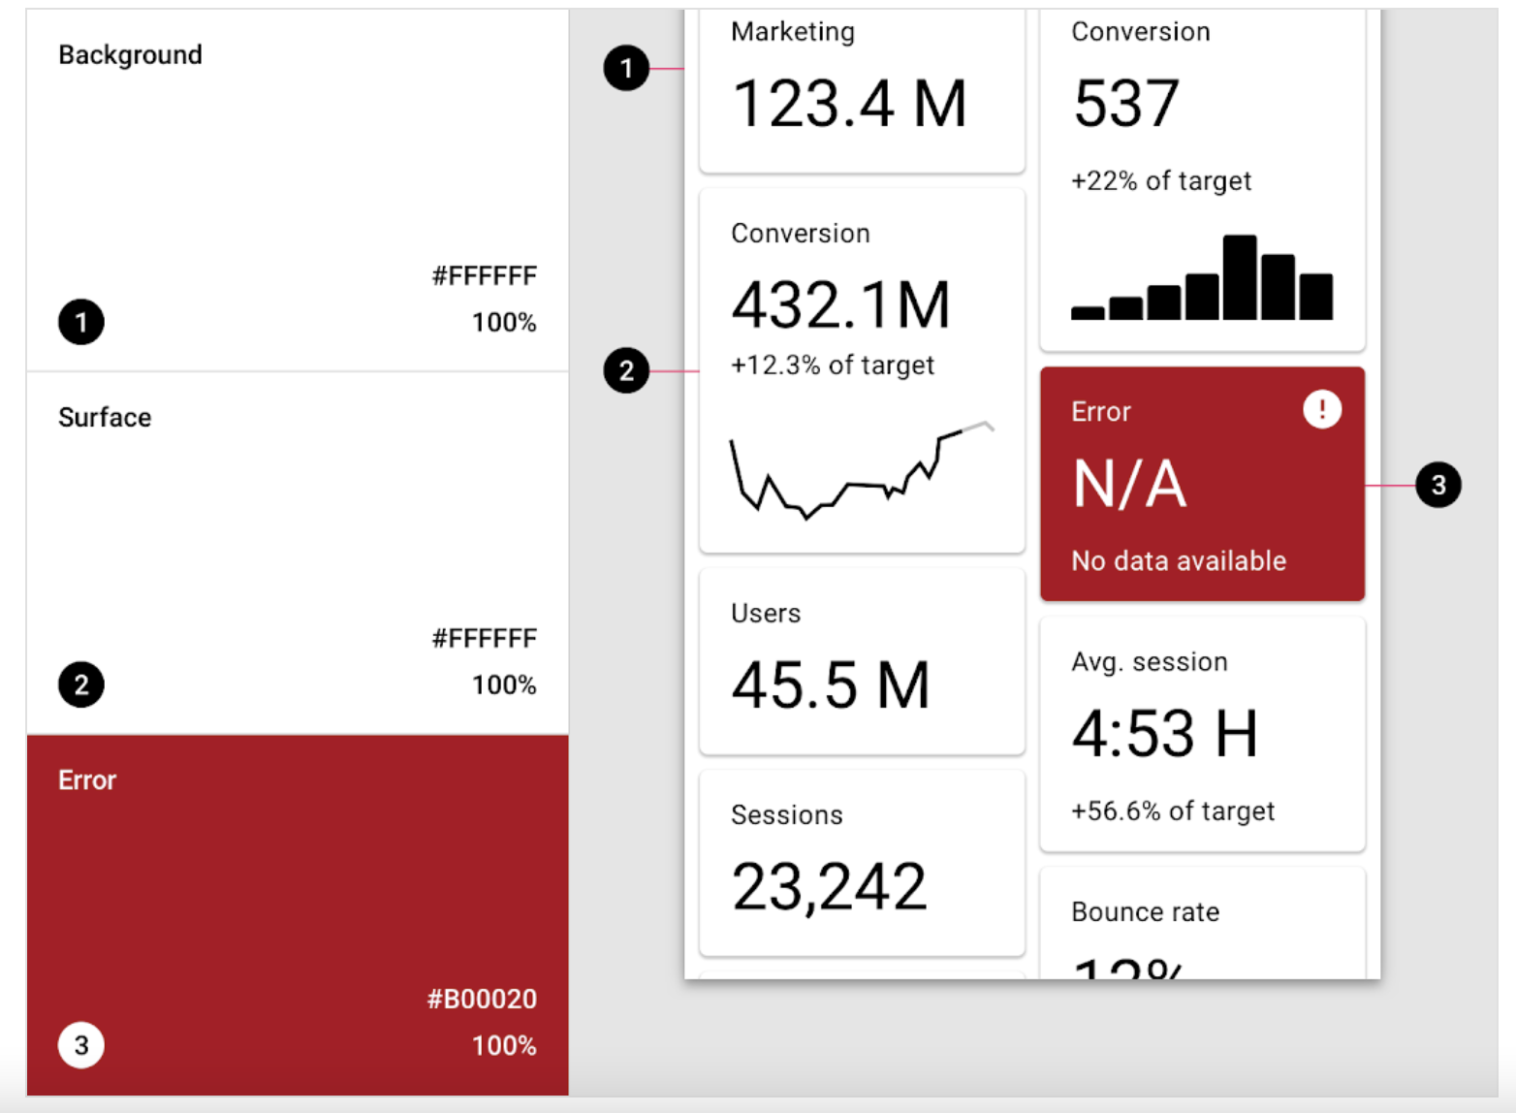
Colores
https://material.io/design/color/the-color-system.html#color-theme-creation

